Slide 1
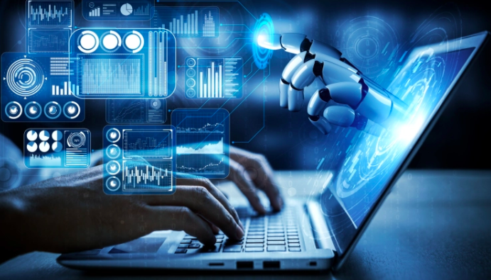
Advanced Machine Learning Techniques
Session –8 & 9 Model Deployment

Slide 3
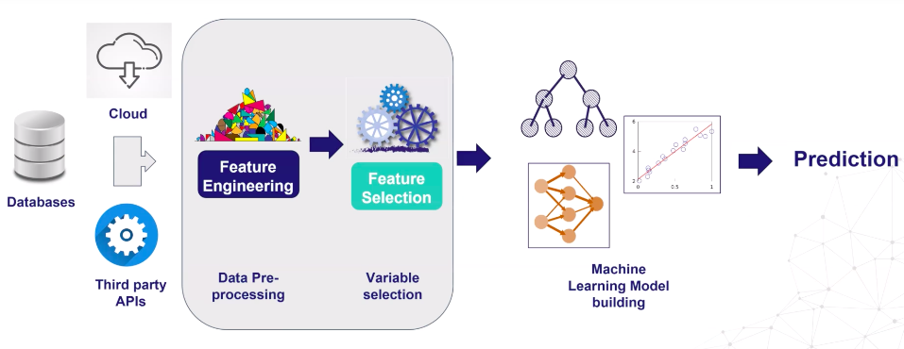
ML Life cycle

Slide 4
Complete ML Life cycle

Slide 5
ML Model Deployment
What?
Making ML model available for production environment.
Integrating ML model to an existing business applications.
Last stage in ML cycle from a data science perspective, but the
starting point from a model management perspective.

Slide 6
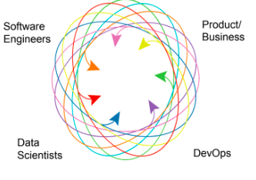

Slide 7
Why do we need deployment?
Trained, but not participating !.

Slide 8
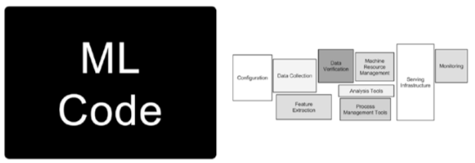
Assumed role of ML in application

Slide 9
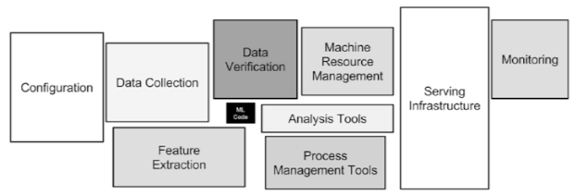
Assumed role of ML vs actual role in application

Slide 10
Deployment Challenges
Traditional Software
Reliability
Reusability
Maintainability
Flexibility
Specific to ML:
Reproducibility

Slide 11
Challenges
Coordination between stake holders.
Programming language discrepancy.
Model drift: because of changing behavior of new data; changing interpretation of new data.
On-premises vs cloud based deployment.
Clear ownership.
Model performance monitoring-When to retrain, what data to be used, benchmark.
Release/ version management.
Security

Slide 12
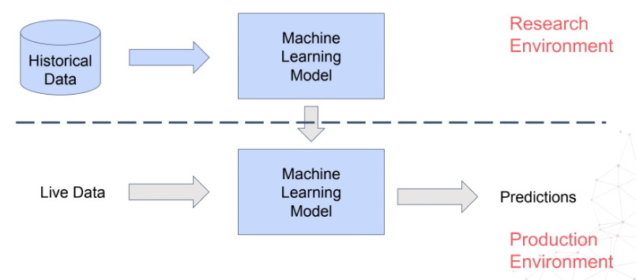
Research and Production Environments
Environment: SW/HW/OS

Slide 13
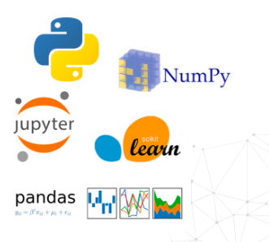
Research Env

Slide 14
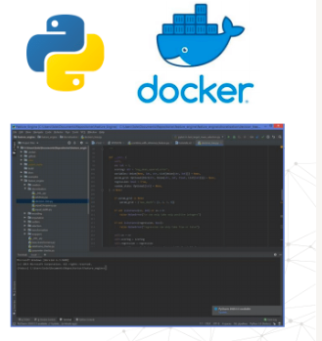
Research Env Production env
Collection, Processing and Development of ML models.
Real time, for business, Live results.

Slide 15
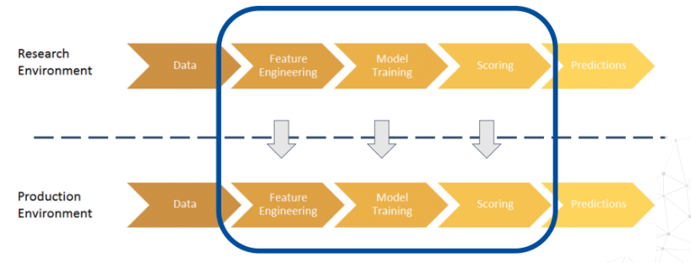
Deployment of ML Pipelines

Slide 16
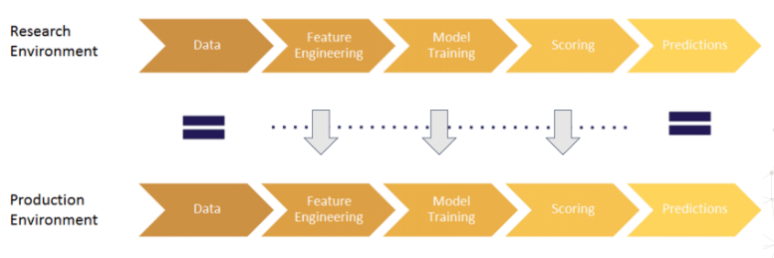
Reproducible ML pipelines

Slide 17
Why reproducibility important
Financial costs
Lost time
Lost reputation

Slide 18
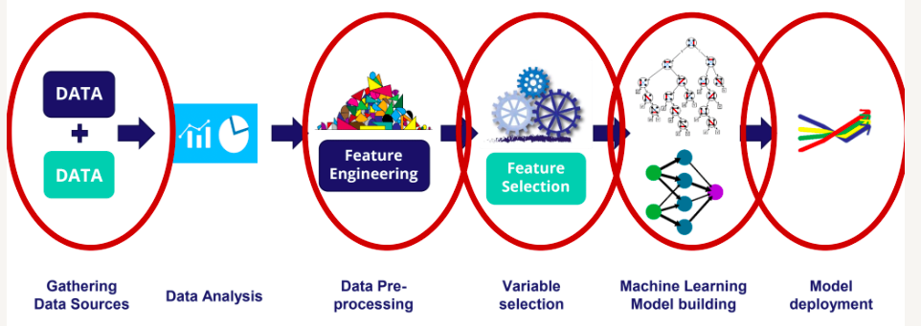

Slide 19
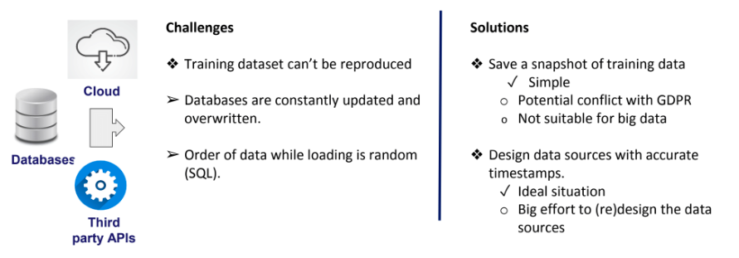
Reproducibility during data gathering

Slide 20
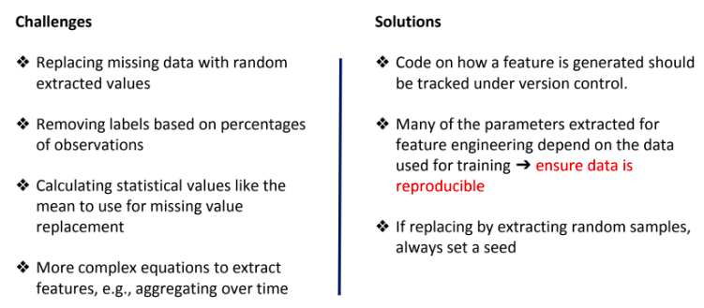
Reproducibility during feature engineering

Slide 21
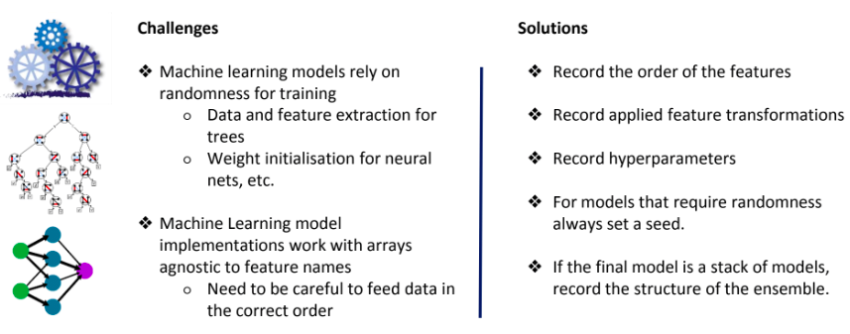
Reproducibility during model training

Slide 22
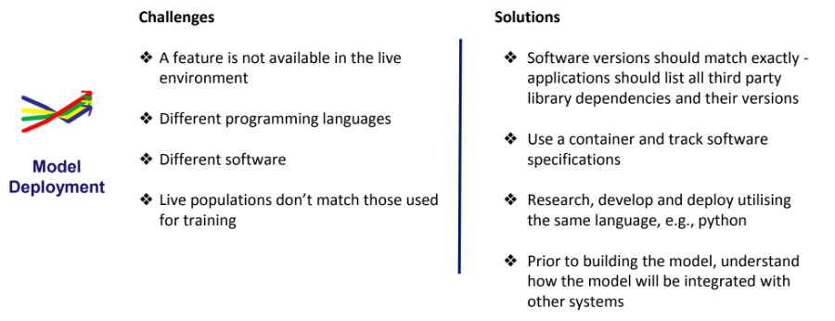
Reproducibility during deployment

Slide 23
Reproducible Pipeline challenges:
A Lot of code: Lot of time, different versions across team
Repetitive: Different copies/versions of same; difficulty in keeping track.
Learn and store parameters: Multiple parameters,
Reproducibility in deployment: Rewrite code, tests,

Slide 24
Open source tools
Flask
Streamlit
FastAPI

Slide 25
Saving ML models
Pickle
joblib

Slide 26
implementation
https://www.amplemarket.com/blog/serving-machine-learning-models-with-fastapi

Slide 27
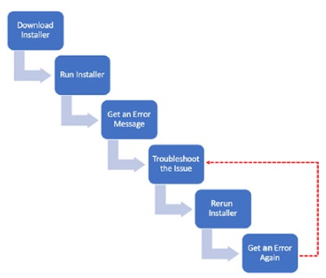
Issue 1

Slide 28
Issue 2
ML code with the developer.
Send to somebody for testing
It might fail, due to- dependency issue, OS issues, platform issues.

Slide 29
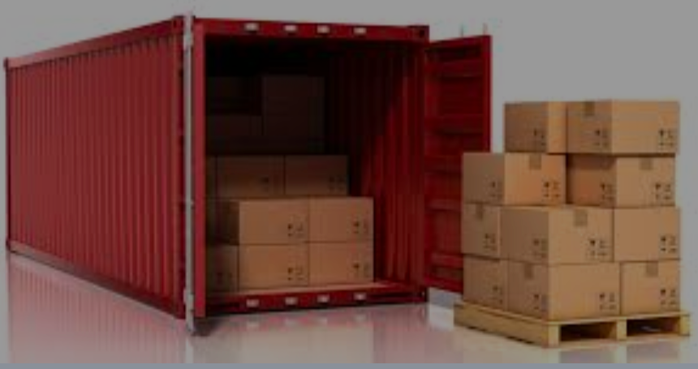
Docker

Slide 30
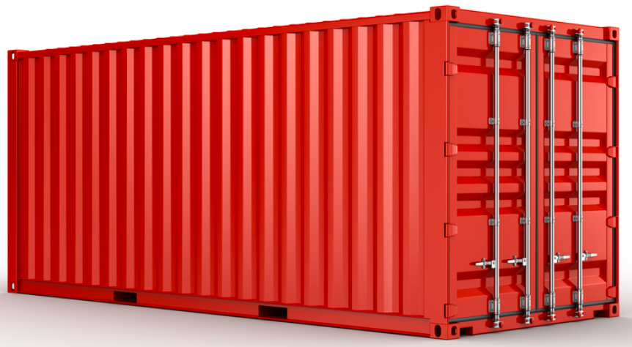
Docker
PaaS: 2013

Slide 31
Docker
A computer program that performs OS level virtualization / containerization.
It packages the application and all its dependencies together in the form of a docker container.
We can replicate the application irrespective of the host.

Slide 32
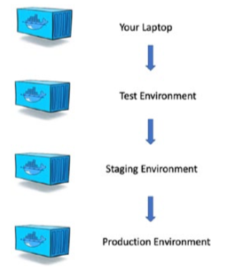
Docker

Slide 33
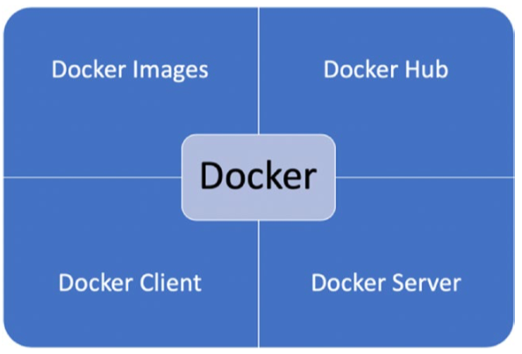
Docker ecosystem

Slide 34
Docker ecosystem
Docker image: We need a docker file to build a docker image.
Docker file is a simple text file.
Docker hub: Repository of all docker images.
Docker Client: The gateway to interact with docker on any system.
Docker server is the one which executes the commands.

Slide 35
Docker process
Train the ML model.
Save and export the ML model.
Create a Flask/Fast API app.
Build a custom Docker image for the app.
Run the app using a Docker container.
Stop the container.

Slide 36
Kubernetes
Kubernetes is an orchestration platform.
It is used for deploying and managing large containers.
It can run large number of containers.
Different cloud platforms offer Kubernetes.

Slide 37
Platforms offering kubenetes
https://cloud.google.com/kubernetes-engine
https://aws.amazon.com/ecs/ - Amazone Elastic Contain Service
https://azure.microsoft.com/en-in/product-categories/containers/ - MS Azure container services

Slide 38
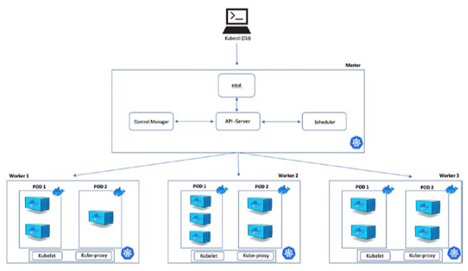
Kubernetes platform
Master
Worker

Slide 39
Kubernetes platform - Master
API Server, allows to interact with different objects,
Scheduler
Control Manager
Etcd, captures current state of a cluster

Slide 40
Kubernetes platform - Worker
Kubelet, primary node agent that runs on each worker node.
Kube-proxy, maintains the distributed networking configuration.

Slide 41
Docker vs Kubernetes
Docker: Used to isolate application into containers. It is used to pack and ship your application.
Kubernetes: A container scheduler. It is used to deploy and scale your application.

Slide 42
Complete ML Life cycle

